Slide 1
Link Analysis (Part I) Professor Wei-Min Shen University of Southern California
With slide contributions from
J. Leskovec, Anand Rajaraman, Jeffrey D. Ullman

Slide 2
OUTLINE
Problem and Motivation
How to rank a web page?
Three Approaches
Page Rank
Topic-Specific (personalized) Page Rank
Web Spam Detection

Slide 3
Web as a Graph
Web as a directed graph:
Nodes: Webpages
Edges: Hyperlinks
I teach a class on Networks.
CS224W: Classes are in the Gates building
Computer Science Department at Stanford
Stanford University

Slide 4
Web as a Graph
Web as a directed graph:
Nodes: Webpages
Edges: Hyperlinks
I teach a class on Networks.
CS224W: Classes are in the Gates building
Computer Science Department at Stanford
Stanford University

Slide 5
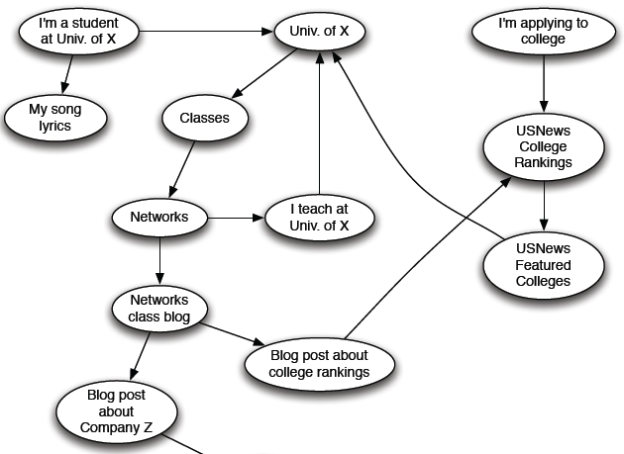
Web as a Directed Graph

Slide 6

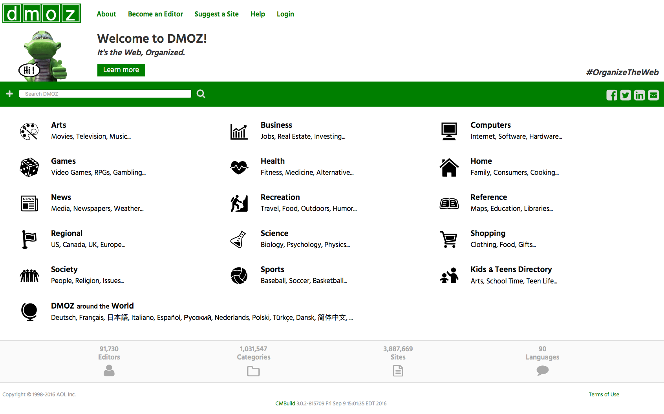
Broad Question
How to organize the Web?
First try: Human curated Web directories
Yahoo, DMOZ, LookSmart

Slide 7
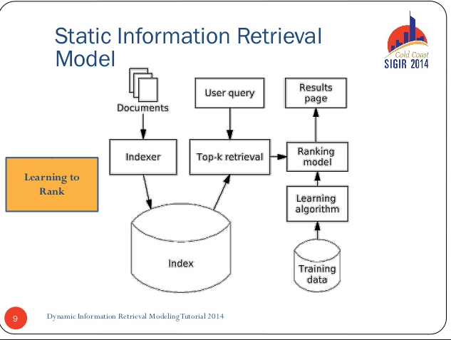
Broad Question (Cont’d)
How to organize the Web?
Second try: Web Search
Information Retrieval investigates: Find relevant docs in a small and trusted set
Newspaper articles,
patents, etc.
But: Web is huge, full of untrusted documents, random things, web spam, etc.

Slide 8
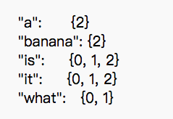
Early Web Search
Keywords extracted from web pages
E.g., title, content
Used to build inverted index
Queries are matched with web pages
Via lookup in the inverted index
Pages ranked by occurrences of query keywords

Slide 9
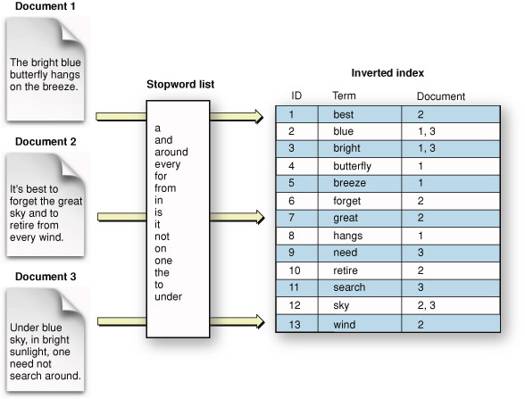
Inverted Index
Problem: susceptible to term spam
https://developer.apple.com/library/mac/documentation/UserExperience/Conceptual/SearchKitConcepts/searchKit_basics/searchKit_basics.html

Slide 10
Term Spam
Disguise a page as something it is not about
E.g., adding thousands of keyword “movies”
Actual content may be some advertisement
Fool search engine to return it for query “movies”
May even fade spam words into background
Spam pages may be based on top-ranked pages

Slide 11
Web Search: Two Challenges
Two challenges of web search:
(1) Web contains many sources of information Who to “trust”?
Trick: Trustworthy pages may point to each other!
(2) What is the “best” answer for a query “newspaper”?
No single right answer
Trick: Pages that actually know about newspapers might all be pointing to many newspapers

Slide 12
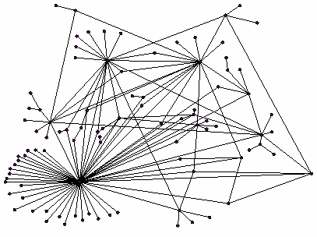
Ranking Nodes on the Graph
All web pages are not equally “important”
blog.bob.com vs. www.usc.edu
There is large diversity in the web-graph node connectivity
Let’s rank the pages by the link structure!

Slide 13
Link Analysis Algorithms
We will cover the following Link Analysis approaches for computing importance of nodes in a graph:
Page Rank
Topic-Specific (Personalized) Page Rank
Web Spam Detection Algorithms

Slide 14
PageRank: The “Flow” Formulation

Slide 15
PageRank: Combating Term Spam
Key idea: rank pages by linkage too
How many pages point to a page
How important these pages are
=> PageRank
USC.edu can be important
because many pages point to it
Your home page can be important
If it is pointed to by USC ☺
Manually counting is impractical
What to do?
USC
You
Notes:
2018 summer 1.2

Slide 16
Random Surfer Model
Random surfer of web
starts from any page
follows its outgoing links randomly
Page is important if it attracts a large # of surfers
Fake
Fake
…
Spam
Los Angeles
Fake
USC
Me
You

Slide 17
PageRank
What is the Probability that a random surfer lands on the page?
Fake
Fake
…
Spam
Los Angeles
Fake
USC
Me
You

Slide 18
Intuition
If a page is important, then
many other pages may directly/indirectly link to it
random surfer can easily find it
Spam pages are less connected
So less chance to attract random surfer
Random surfer model more robust than manual approach
A collective voting scheme

Slide 19
Example: PageRank Scores
B
38.4
C
34.3
A
3.3
D
3.9
E
8.1
F
3.9
1.6
1.6
1.6
1.6
1.6

Slide 20
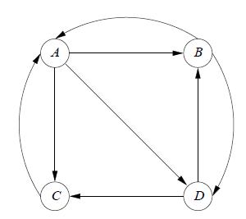
Assumption: A Strongly Connected Web Graph
Nodes = pages
Edges = hyperlinks between pages
every node is reachable from every other node
Notes:
every vertex is reachable from every other vertex

Slide 21
Model: Random Surfer on the Graph
Can start at any node
If at A, can next go to B, C, or D, each with 1/3 prob.
If at B, can go to A and D, each with 1/2 prob.
So on…

Slide 22
Random Surfer Property: Memoryless
Where to go from node X is not affected by how the surfer got to X

Slide 23
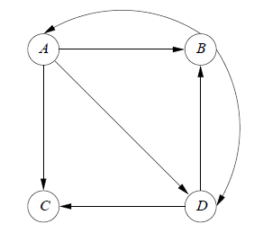
Extreme Case: Dead End
Dead end: a page with no edges out
Absorb PageRanks
PageRank => 0 for any page that can reach the dead end (including the dead end itself)
Dead end

Slide 24
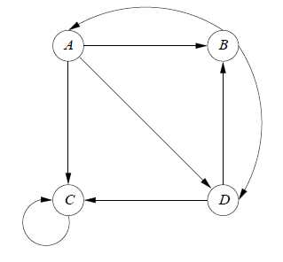
Extreme Case: Spider Trap
Group of pages with no edges going out of group
Absorb all PageRanks (rank of C =>1, others =>0)
Surfer can never leave, once trapped
Can have > 1 such trap nodes
Spider trap

Slide 25
PageRank: Formulation Details
Notes:
2019Spring 01

Slide 26
PageRank: Links as Votes
Idea: Links as votes
Page is more important if it has more links
In-coming links? Out-going links?
Think of in-links as votes:
www.stanford.edu has 23,400 in-links
www.inf553.cs.usc.edu has 1 in-link
Are all in-links equal?
Links from important pages count more
A Recursive question!

Slide 27
Simple Recursive Formulation
Each link’s vote is proportional to the importance of its source page
If page j with importance r_{j} has n out-links, each link gets r_{j} /n votes
Page j’s own importance is the sum of the votes on its in-links
i
k
r_{i}/3
r_{k}/4
r_{j} = r_{i} /3+r_{k} /4
j
r_{j}/3
r_{j}/3
r_{j}/3

Slide 28
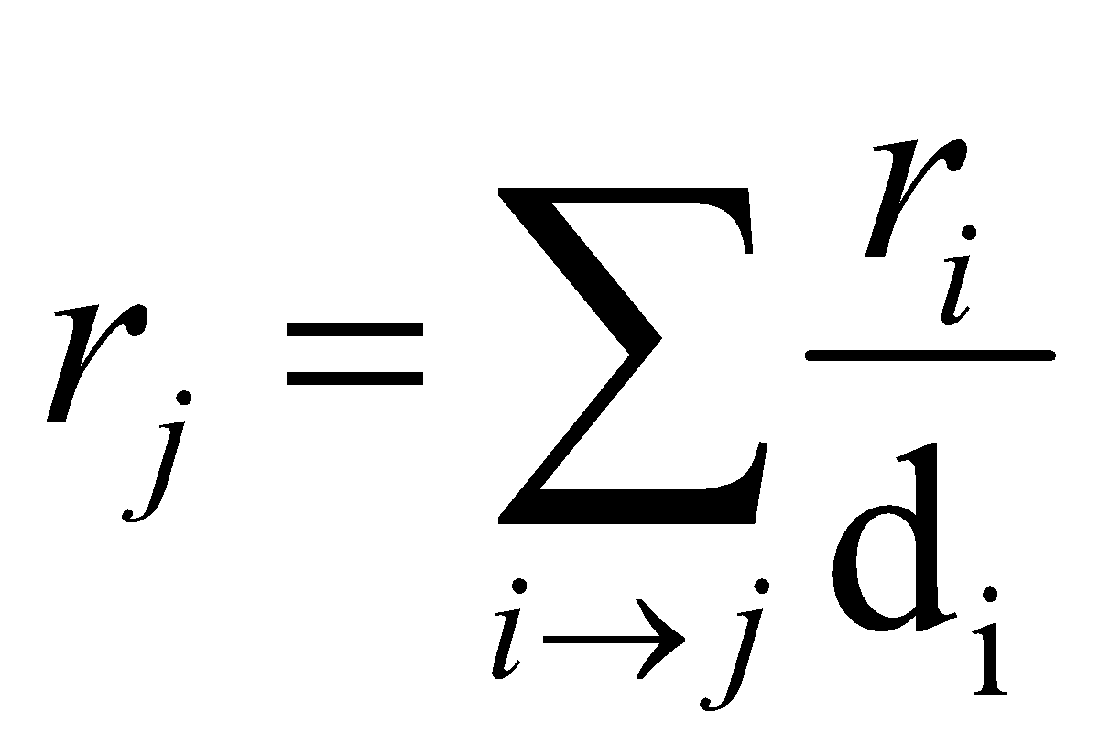
PageRank: The “Flow” Model
A “vote” from an important page is worth more
A page is important if it is pointed to by other important pages
Define a “rank” r_{j} for page j
y/2
y
a/2
y/2
m
a
m
a/2
“Flow” equations:
r_{y} = r_{y} /2 + r_{a} /2
r_{a} = r_{y} /2 + r_{m}
r_{m} = r_{a} /2
d_{i} = out-degree of node i

Slide 29
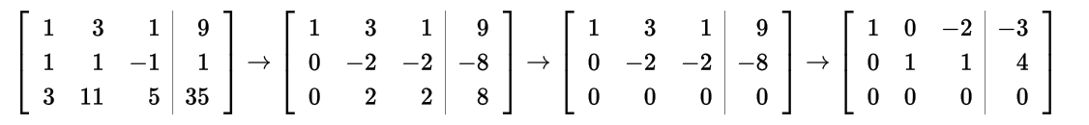
Solving the flow equations
“Flow” equations:
r_{y} = r_{y} /2 + r_{a} /2
r_{a} = r_{y} /2 + r_{m}
r_{m} = r_{a} /2
3 equations, 3 unknowns, no constants
No unique solution
All solutions equivalent modulo scale factor
Additional constraint forces uniqueness
Add some constant constraints: e.g., r_{y} + r_{m} + r_{a} = 1
Solve for unique solutions: r_{y} = 2/5, r_{a} = 2/5, r_{m} = 1/5
Gaussian elimination method (in later slides) works for small examples, but we need a better method for large graphs

Slide 30
PageRank: Matrix formulation
Stochastic Transition (or adjacency) Matrix M
Suppose page j has n outlinks
If outlink j -> i, then M_{ij}=1/n
Else M_{ij}=0
M is a column stochastic matrix
Each column sums to 1

Slide 31
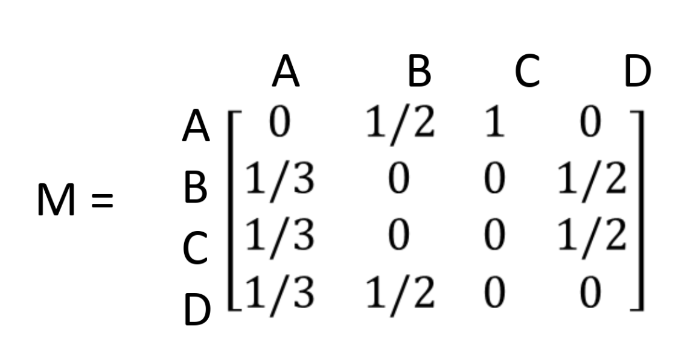
Transition Matrix
M[i,j] = prob. of going from node j to node i
If j has k outgoing edges, prob. for each edge = 1/k
M is a column stochastic matrix: each column sums to 1

Slide 32
PageRank: Matrix formulation (Cont’d)
Stochastic Transition (or adjacency) Matrix M
Suppose page j has n outlinks
If outlink j -> i, then M_{ij}=1/n
Else M_{ij}=0
M is a column stochastic matrix
Each column sums to 1
Rank vector r is a vector with one entry per web page
r_{i} is the importance score of page I
The flow equations can be written as
r = Mr

Slide 33
Example
Flow equation in matrix form: Mr = r
Suppose page j links to 3 pages, including i
j
i
r_{i}
.
=
r_{j}
1/3
M
.
r
=
r

Slide 34
Stationary Distribution
Limiting probability distribution of random surfer
PageRanks are based on limiting distribution
the probability distribution will converge eventually
Requirement for its existence
Graph is strongly connected: a node can reach any other node in the graph
=> Cannot have dead ends, spider traps

Slide 35
Eigenvectors and Eigenvalues
An eigenvector v of a square matrix A is a non-zero vector v that, when the matrix multiplies v, yields the same as when some scalar multiplies v, the scalar multiplier often being denoted by λ
That is:
Av = λv
The number λ is called the eigenvalue of A corresponding to v

Slide 36
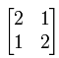
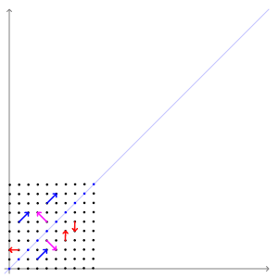
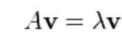
Eigenvalues and Eigenvectors Example
The transformation matrix A = preserves the direction of vectors parallel to v = (1,−1)^{T} (in purple) and w = (1,1)^{T} (in blue). The vectors in red are not parallel to either eigenvector, so, their directions are changed by the transformation.
http://setosa.io/ev/eigenvectors-and-eigenvalues/
https://en.wikipedia.org/wiki/Eigenvalues_and_eigenvectors

Slide 37
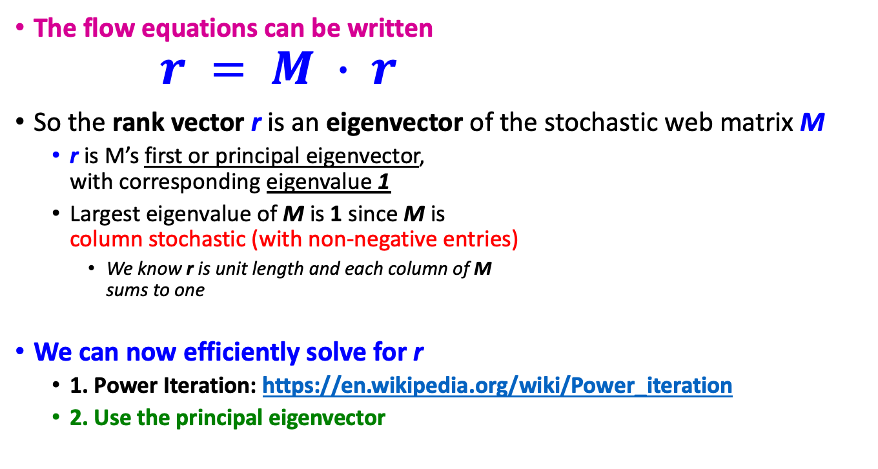
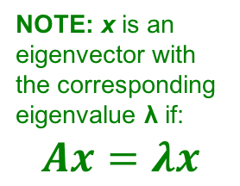
Eigenvector Formulation
limiting distribution

Slide 38
Example
y a m
Yahoo
y 1/2 1/2 0
a 1/2 0 1
m 0 1/2 0
r = Mr
Amazon
M’soft
r_{y} 1/2 1/2 0 r_{y} r_{a} = 1/2 0 1 r_{a} r_{m} 0 1/2 0 r_{m}
r_{y} = r_{y} /2 + r_{a}/2
r_{a} = r_{y} /2 + r_{m}
r_{m} = r_{a}/2

Slide 39
Two Approaches for Solving Mv = v
Power Iteration
Repeatedly solving Mv^{k} = v^{k+1}
Finding the Eigenvectors
Solving Mv = λv, or (M – I)v = 0
Gaussian Elimination

Slide 40
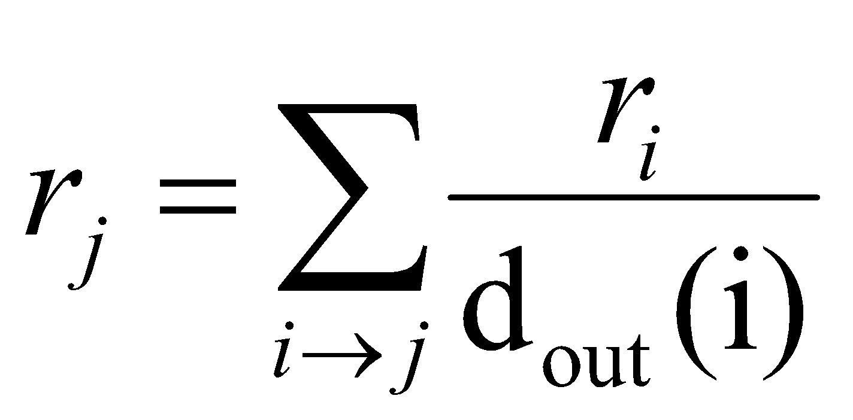
Random Walk Interpretation
Imagine a random web surfer:
At any time t, surfer is on some page i
At time t+1, the surfer follows an out-link from i uniformly at random
Ends up on some page j linked from i
Process repeats indefinitely
Let:
p(t) … vector whose i^{th} coordinate is the probability that the surfer is at page i at time t
So, p(t) is a probability distribution over pages
-> rank vector
i₁
i₂
i₃
j
Notes:
2016Spring W1-1

Slide 41
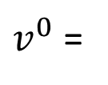
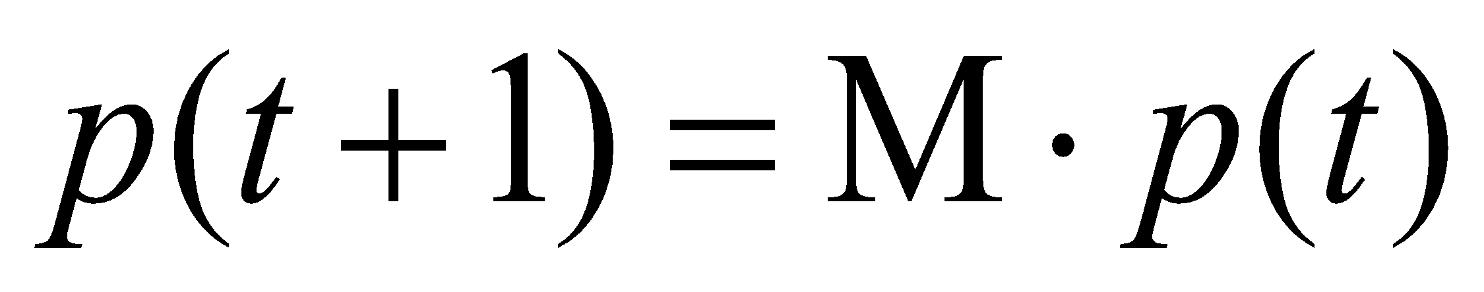
The Stationary Distribution
i₁
i₂
i₃
j
A central result from the theory of random walks (a.k.a. Markov processes):
For graphs that satisfy certain conditions, the stationary distribution is unique and eventually will be reached no matter what the initial probability distribution at time t = 0

Slide 42
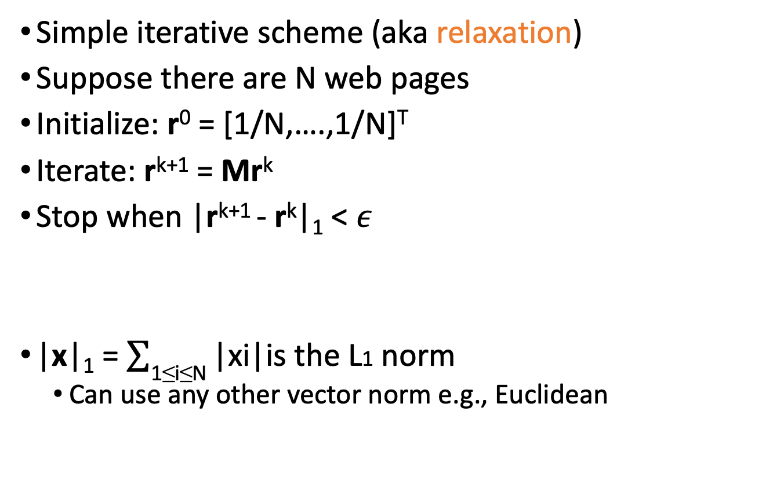
Power Iteration Method

Slide 43
Power Iteration Example 1
Yahoo
y a m
y 1/2 1/2 0
a 1/2 0 1
m 0 1/2 0
Amazon
M’soft
r^{k+1} = Mr^{k}
r_{y}
r_{a} =
r_{m}
1/3
1/3
1/3
1/3
1/2
1/6
5/12
1/3
1/4
3/8
11/24
1/6
2/5
2/5
1/5
. . .

Slide 44
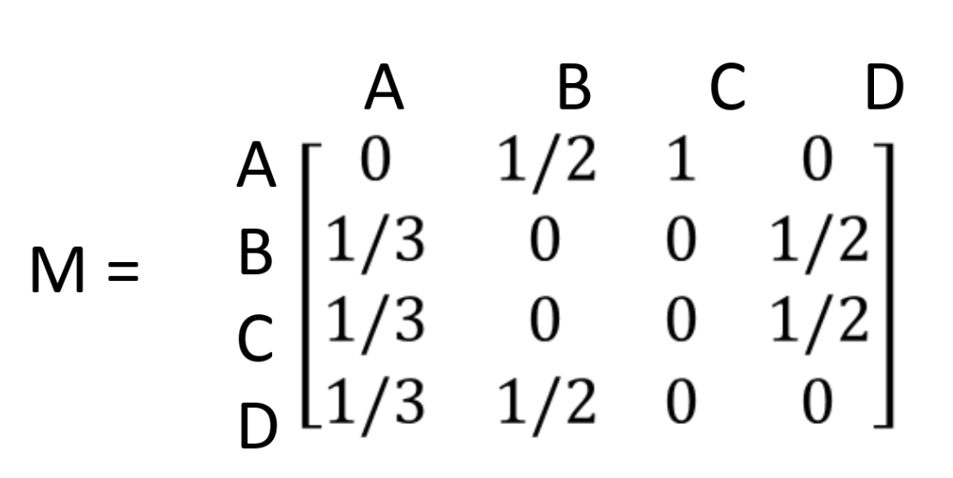
Power Iteration Example 2
M[i,j] = prob. of going from node j to node i
If j has k outgoing edges, prob. for each edge = 1/k

Slide 45
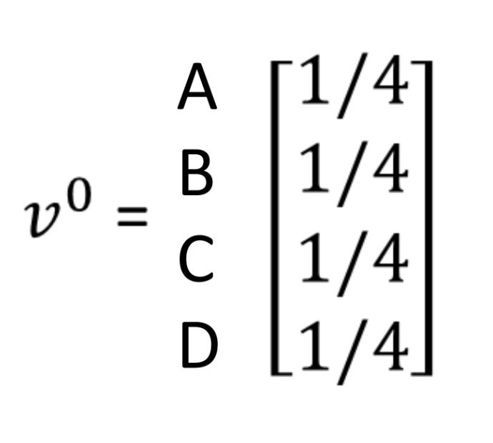
Probability of Locations of Surfer
Represented as a column vector, v
Initially, surfer can be at any page with equal probability

Slide 46
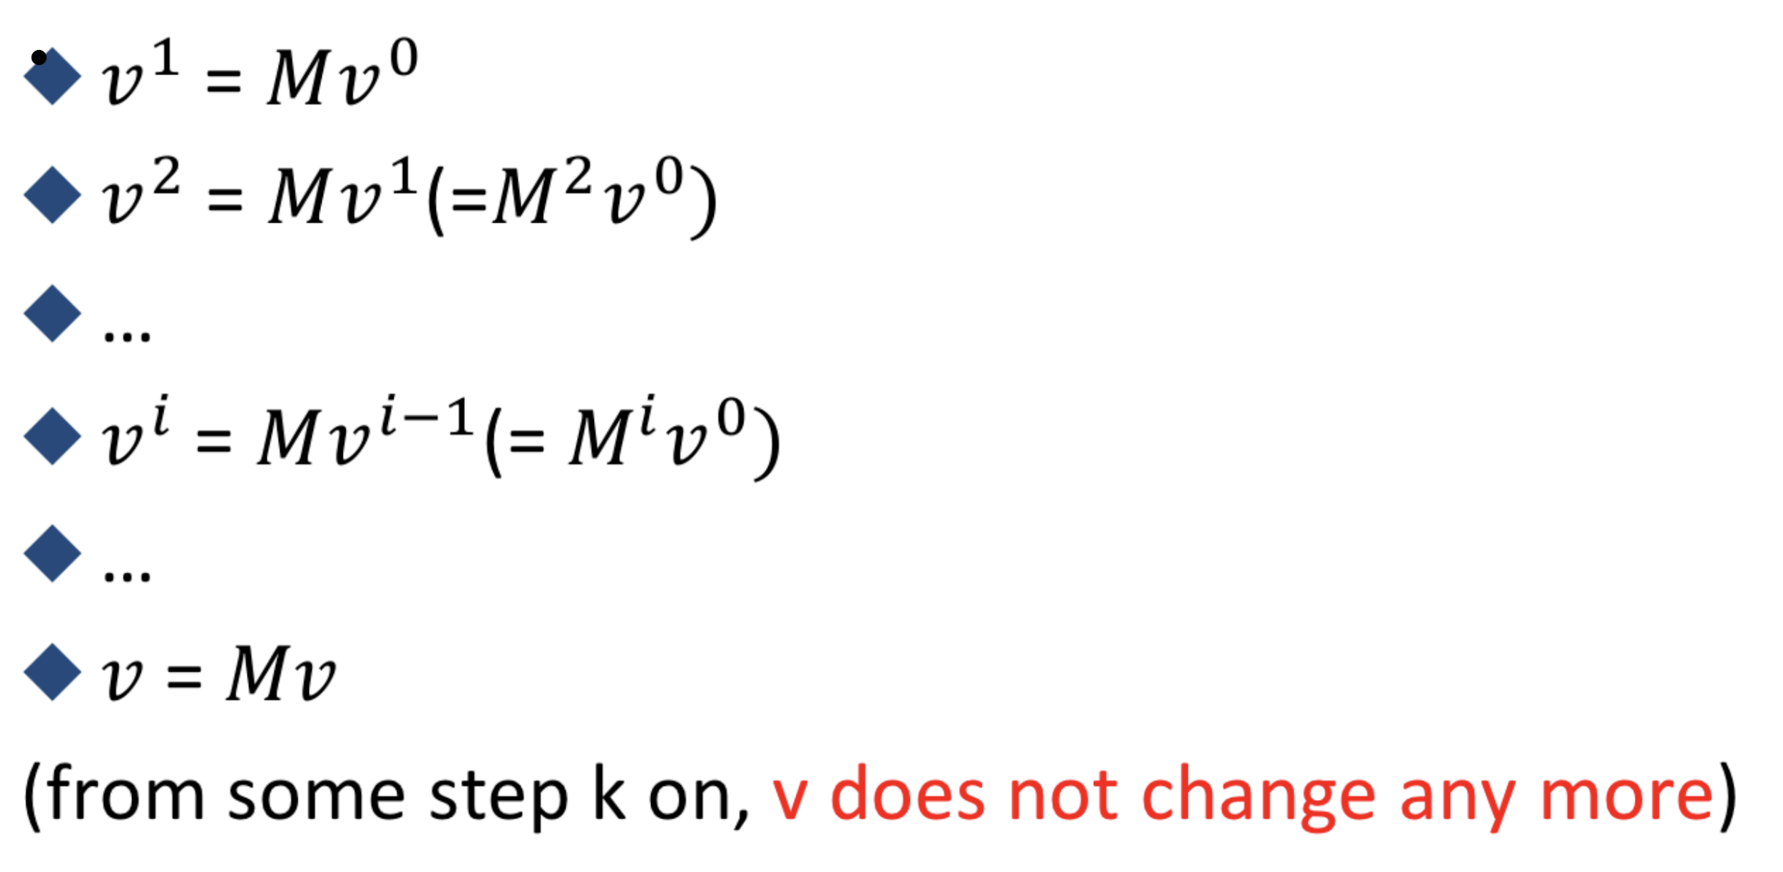
Limiting Distribution

Slide 47
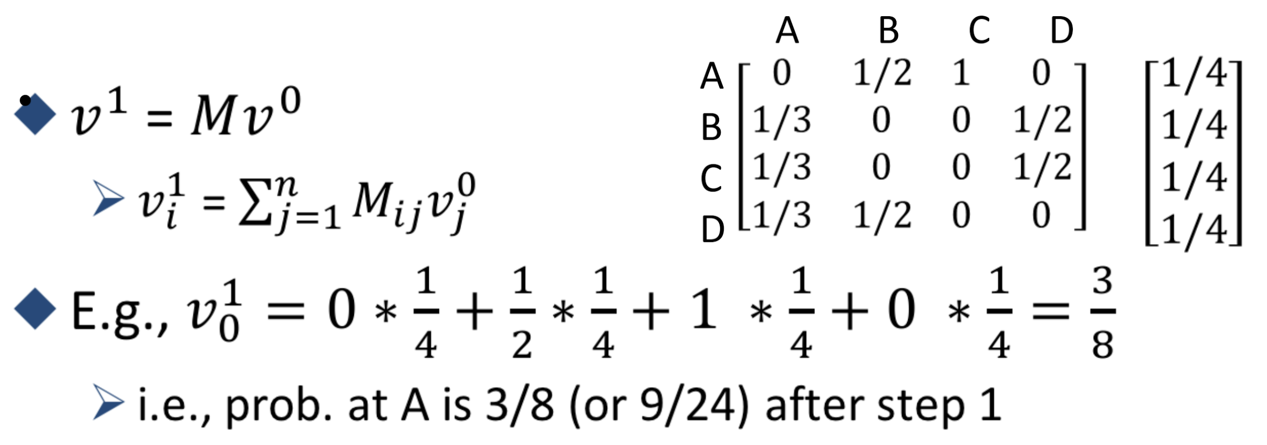
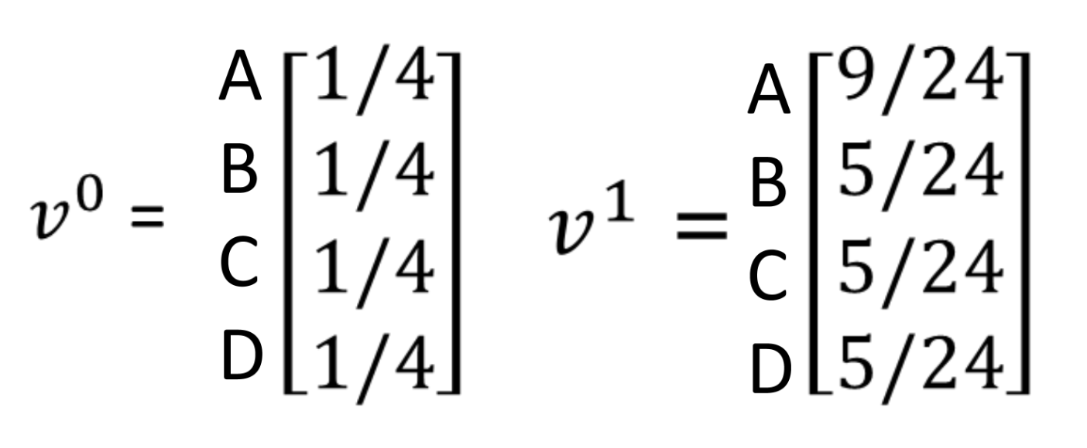
Compute Next Distribution
V ² = ?
V ³ = ?

Slide 48
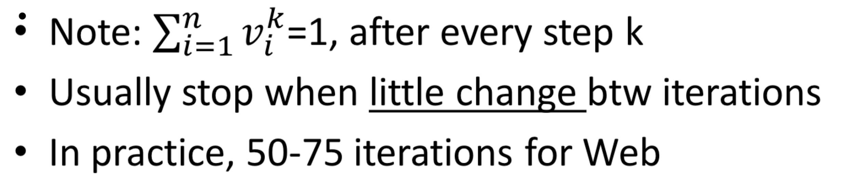
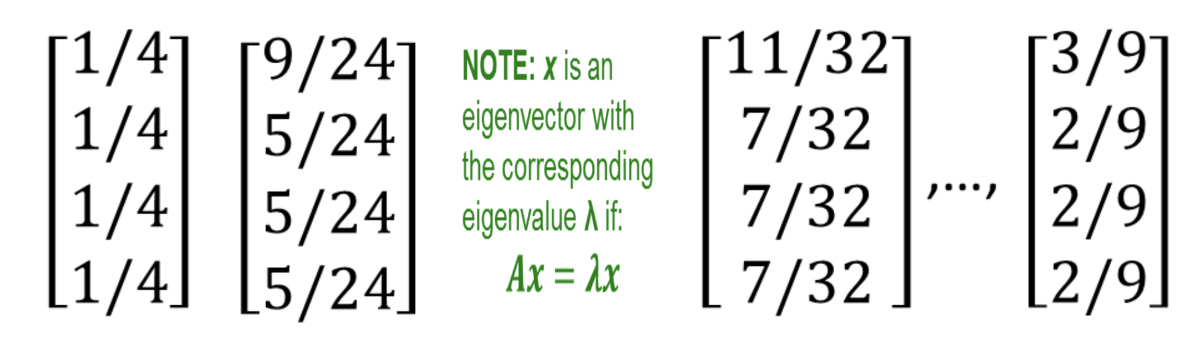
Solving Mv = v by Power Iteration

Slide 49
Two Approaches for Solving Mv = v
Power Iteration
Repeatedly solving Mv^{k} = v^{k+1}
Finding the Eigenvectors
Solving Mv = λv, or (M – I)v = 0
Gaussian Elimination

Slide 50
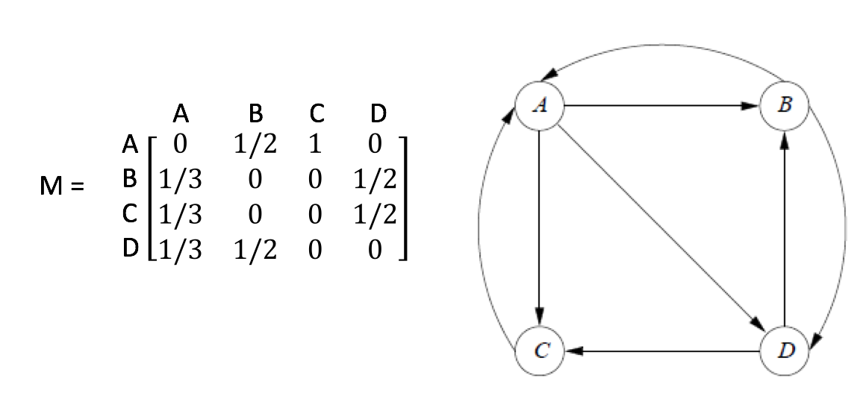
Solving Mv = v by Finding the Principal Eigenvector (when λ=1)
Mν = λν
λ: eigenvalue, ν: eigenvector
M is a (left) stochastic matrix
Each column adds up to 1
Largest eigenvalue of a stochastic matrix is λ=1
Corresponding eigenvector is the principal eigenvector
Proof in the next few slides
Notes:
A right stochastic matrix is a real square matrix, with each row summing to 1.^{[1]}A left stochastic matrix is a real square matrix, with each column summing to 1.^{[1]}
^{2018 w1.1}

Slide 51
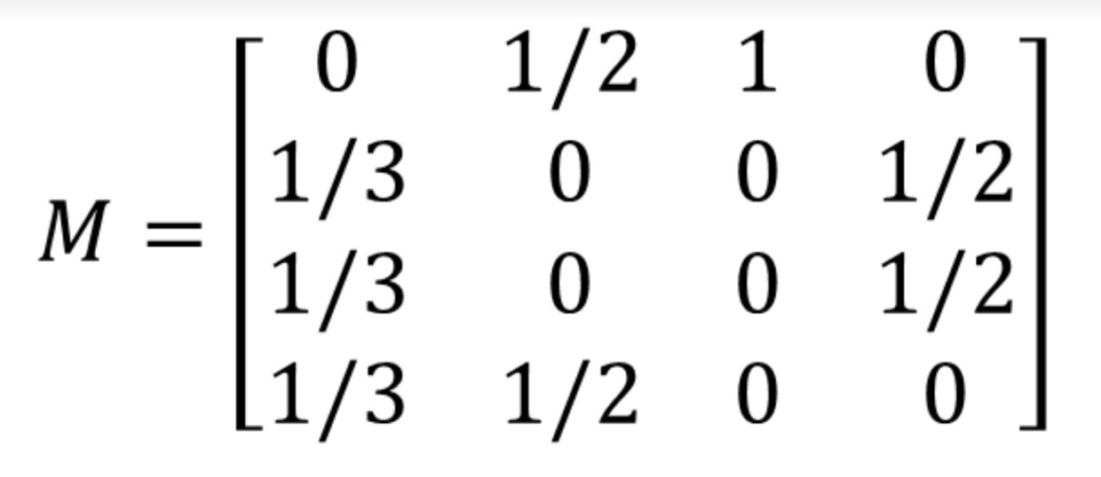
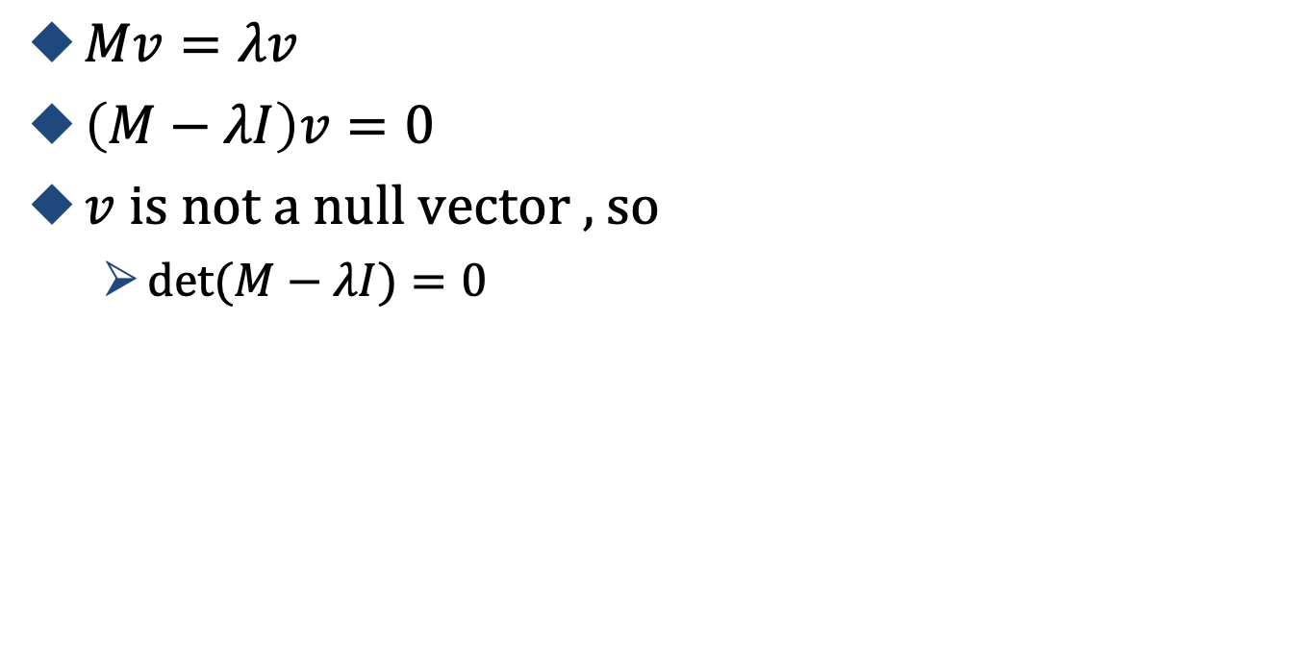
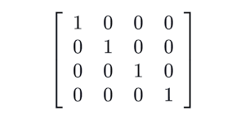
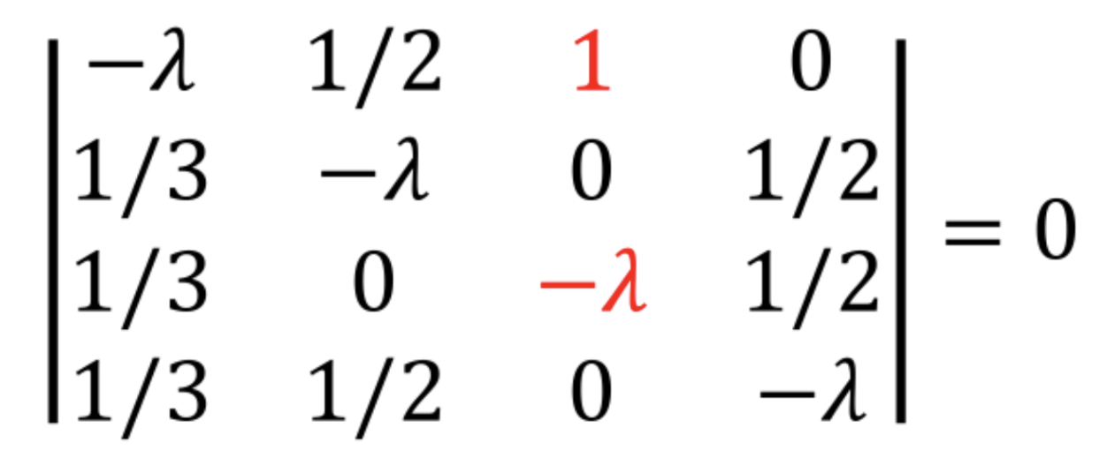
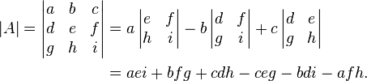
Characteristic Polynomial
Calculating the Eigenvalues
I is the identity matrix
Compute the determinant using cofactors in this column (next slide)
Notes:
Determinant
the characteristic polynomial of a square matrix is a polynomial which is invariant under matrix similarity and has the eigenvalues as roots.
You can use any row or column to compute the determinant
I is the identify matrix
https://en.wikipedia.org/wiki/Characteristic_polynomial

Slide 52
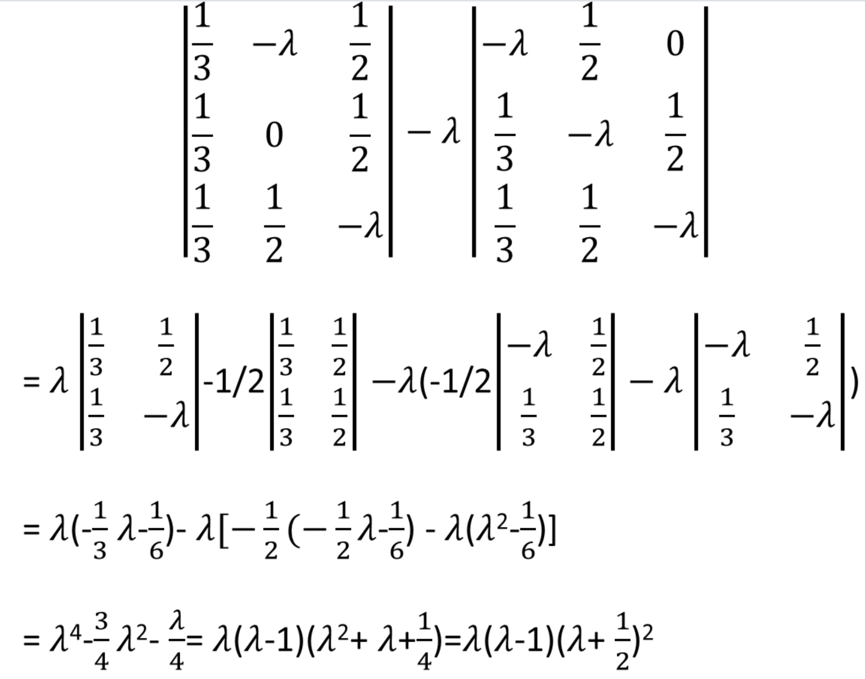
Characteristic Polynomial

Slide 53
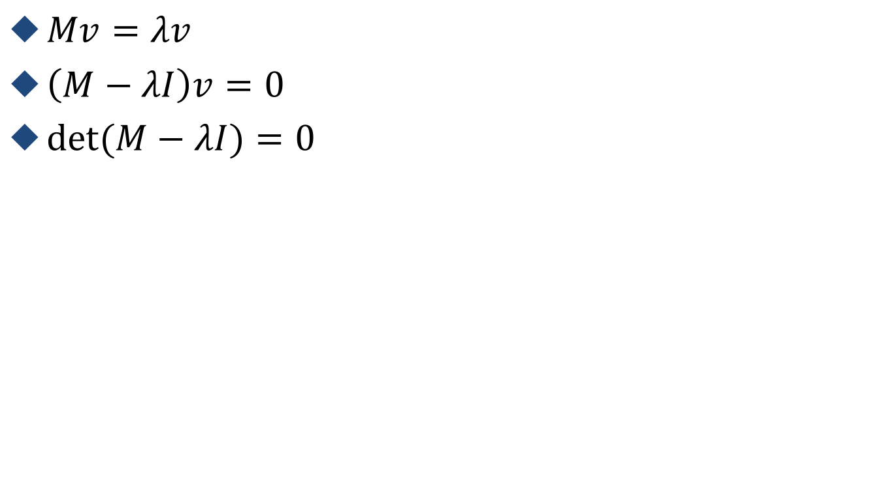
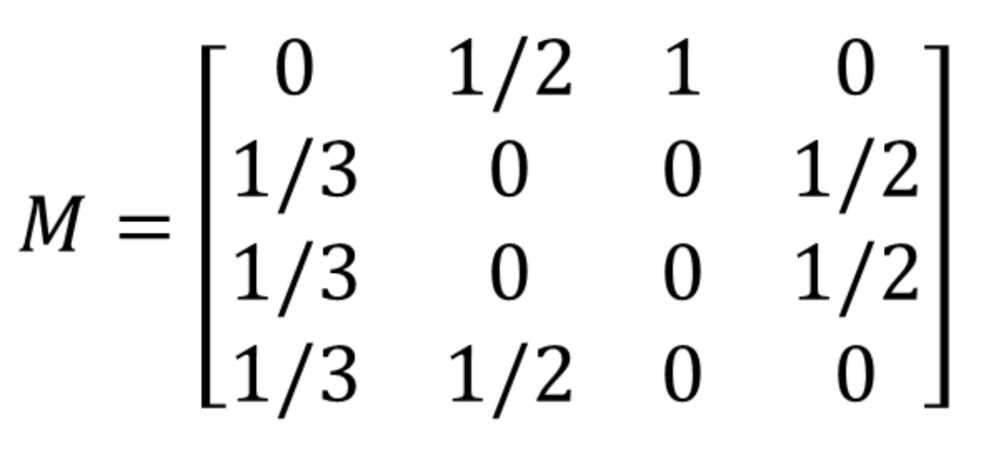
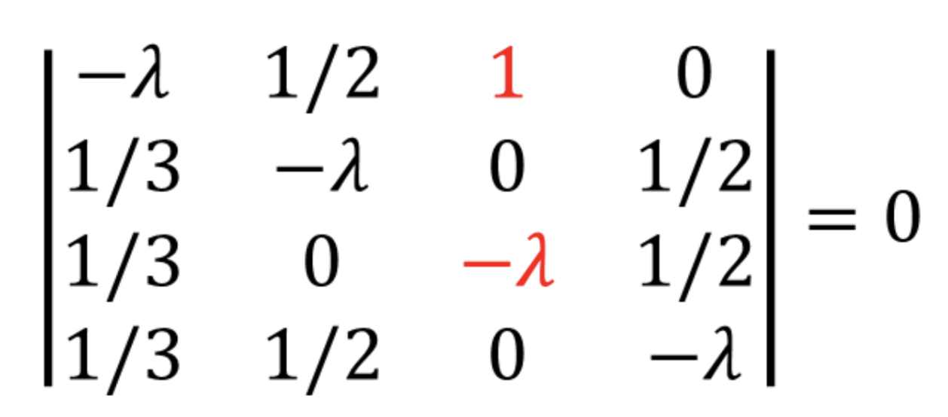
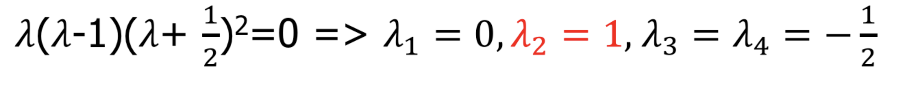
Characteristic Polynomial

Slide 54
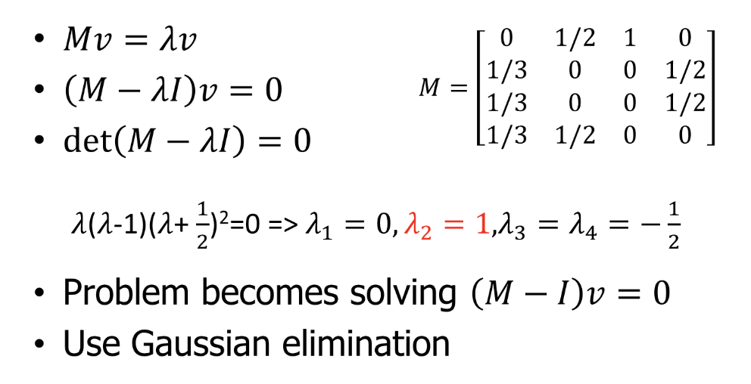
Solving Mv = v by Finding the Principal Eigenvector (when λ=1)

Slide 55
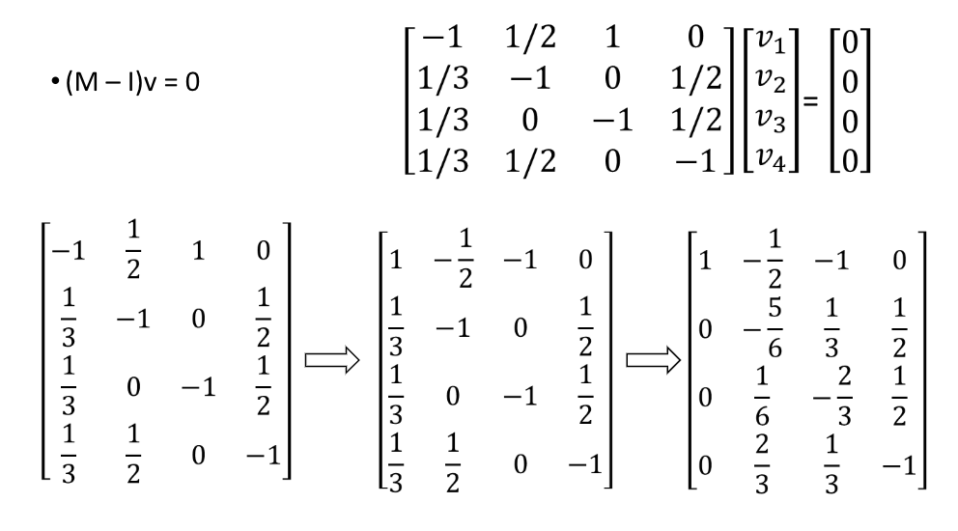
Solving Mv = v by Gaussian Elimination
Notes:
(2) -1/3(1)
===
-1 + 1/6 = -5/6
0 -1/3(-1) = 1/3
-1 -1/3(-1) = -1 +1/3 = -2/3
½-1/3(-1/2) = ½+1/6 = 2/3

Slide 56
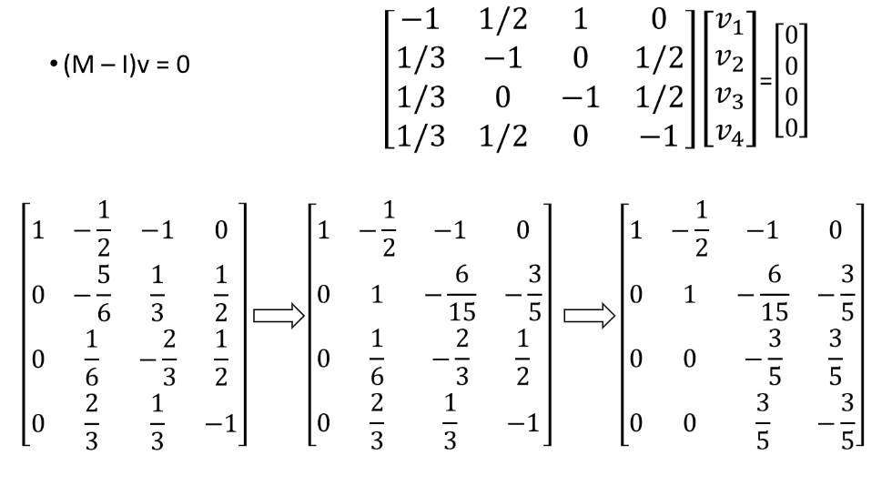
Solving Mv = v by Gaussian Elimination
Notes:
(2) -1/3(1)
===
-1 + 1/6 = -5/6
0 -1/3(-1) = 1/3
-1 -1/3(-1) = -1 +1/3 = -2/3
½-1/3(-1/2) = ½+1/6 = 2/3

Slide 57
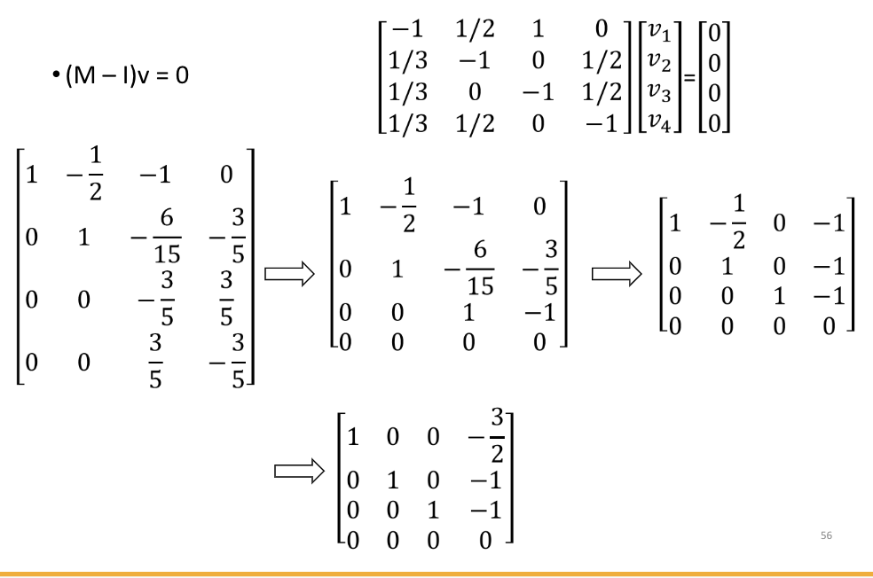
Solving Mv = v by Gaussian Elimination
Notes:
(2) -1/3(1)
===
-1 + 1/6 = -5/6
0 -1/3(-1) = 1/3
-1 -1/3(-1) = -1 +1/3 = -2/3
½-1/3(-1/2) = ½+1/6 = 2/3

Slide 58
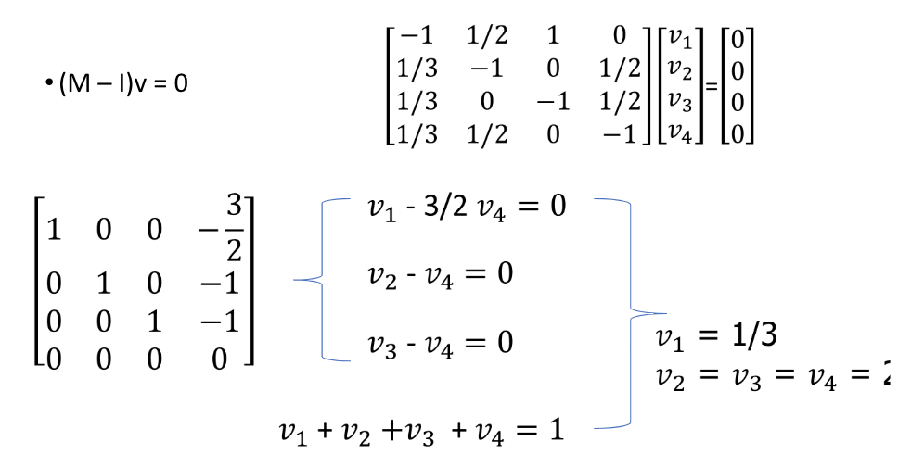
Solving Mv = v by Gaussian Elimination
2/9
The “principal” eigenvector is [1/3, 2/9, 2/9, 2/9], when λ = 1
Notes:
(2) -1/3(1)
===
-1 + 1/6 = -5/6
0 -1/3(-1) = 1/3
-1 -1/3(-1) = -1 +1/3 = -2/3
½-1/3(-1/2) = ½+1/6 = 2/3

Slide 59
Comparison of Solutions
Mv = v
Solution 1: power iteration
Solution 2: Gaussian elimination
Power iteration
Complexity: O(kn²), where k = # of iterations
Gaussian elimination
Complexity: O(n³)
n²+(n-1)²+…+2²

Slide 60
Next Week
Link Analysis (Part II)
Solving the flow model: Mv = v
Power Iteration and Gaussian Elimination
Dead-ends and spider traps (teleporting and taxation)
PageRank for Search Engines (MapReduce)
Topic-specific: (augment for general-popularity)
Trust-Rank: (fighting against link spams)
Hubs-and-Authorities: (multiple importances)

